Slide 1
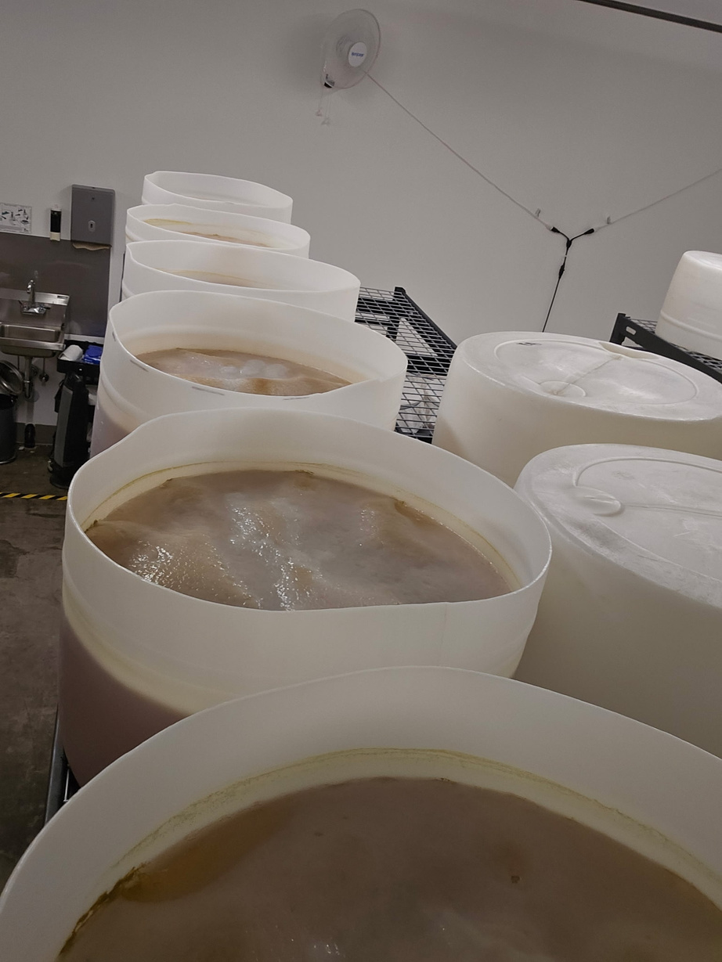
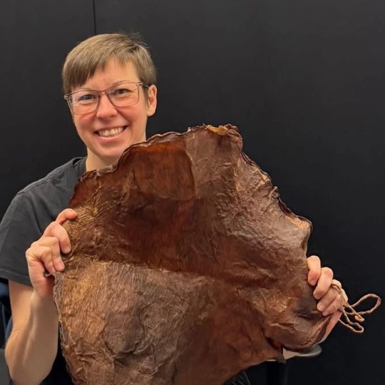
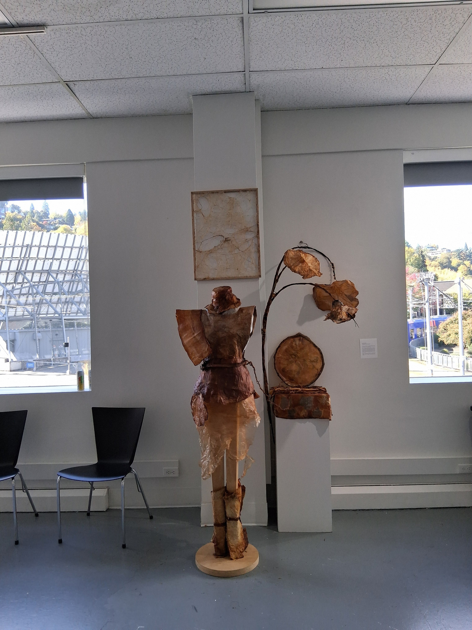



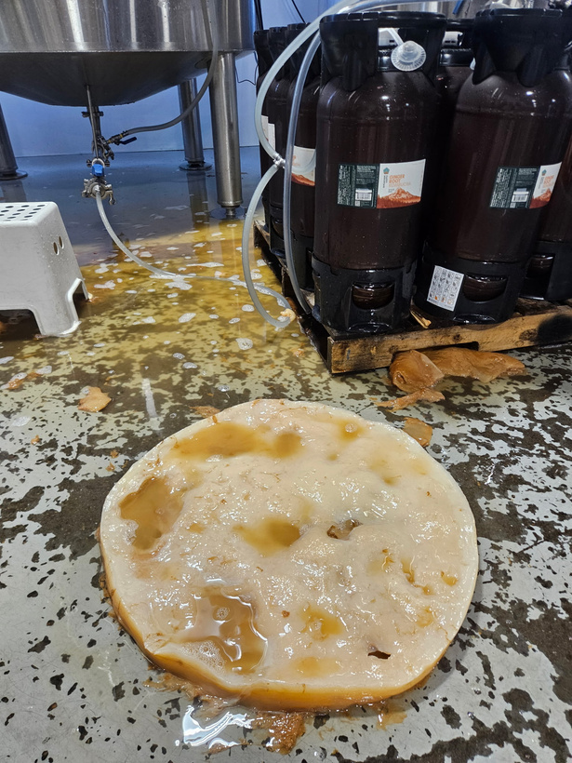

What is Kombucha Textile? SCOBY?

Slide 2
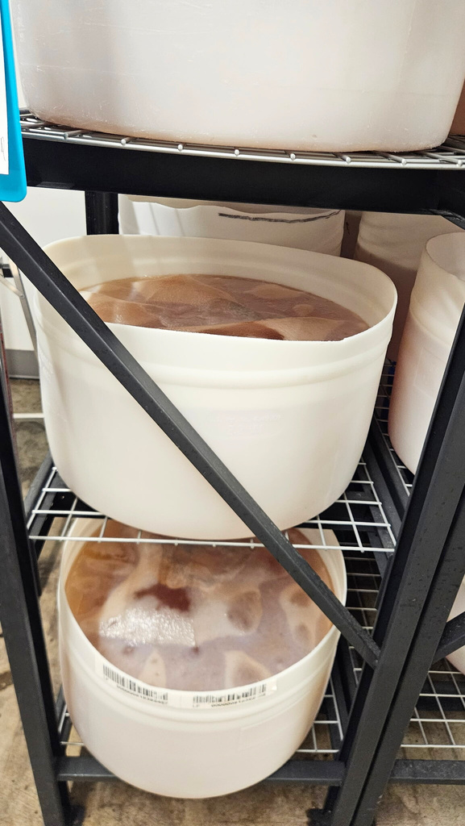
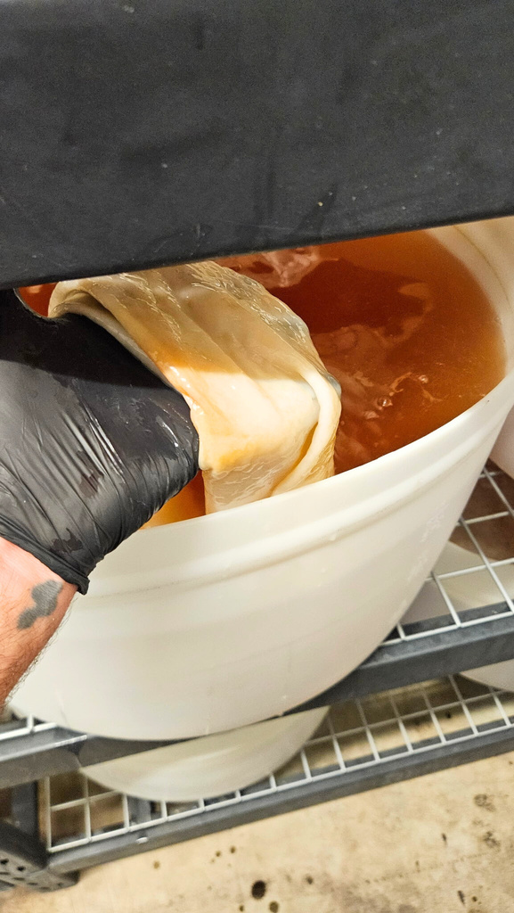
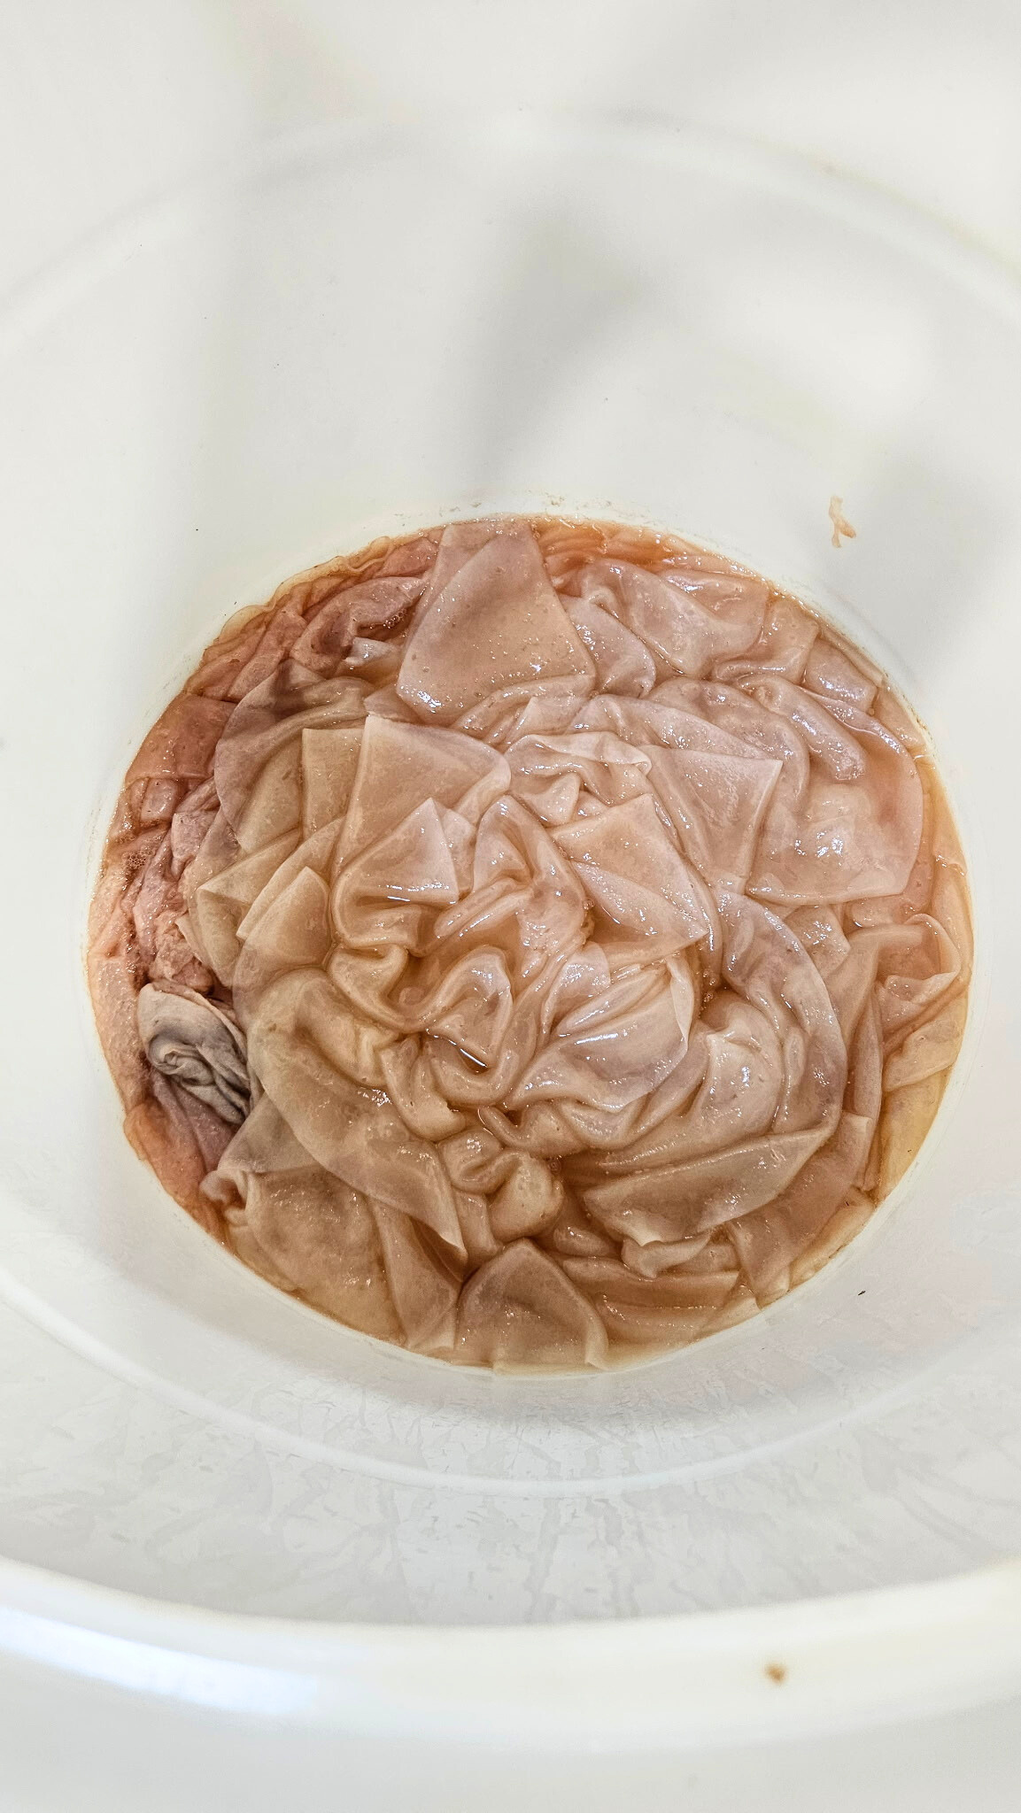
S.C.o.B.Y.

Slide 3
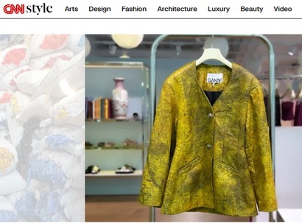
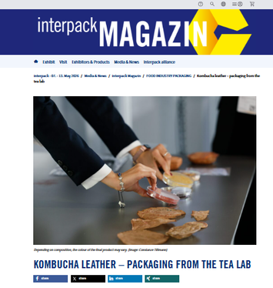
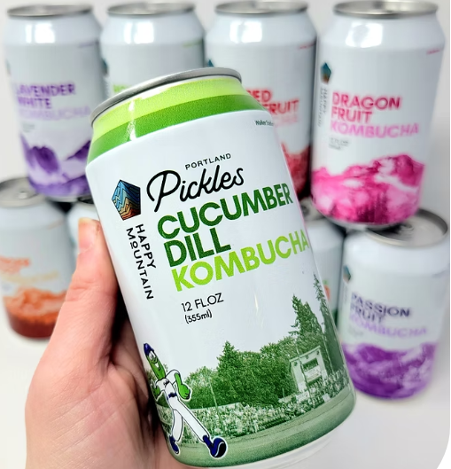
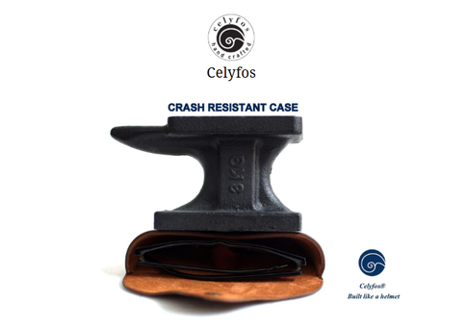
Drink and Textile both!
Kombucha is a mostly experienced as a non-alcoholic Fizzy Drink that is: Pressure Bottled Living Vinegar from Sucrose and Tea (Camelia sinensis) Leaves
S.C.o.B.Y. is an acronym about multi-species cultural co-operation (biological symbiosis) : Symbiotic Culture of Bacteria and Yeast
The Pellicle of the S.C.o.B.Y. is a Networking Opportunity for the micro-organisms like Bacteria and Yeast and macro-organisms like us here in class.
It has textile potential across industries, including fashion, agriculture, food packaging, and more. It is strong but rips in seams if not layered or cured properly.

Slide 4
finding pellicle
where and how?
-brew it yourself: pellicle can be grown in any size tank, and it grows on the surface, to the size of the whole surface area
-pick it up from a brewery
-collect it from a group of friends who all brew
where have you experienced kombucha that you would be able to access it?

Slide 5






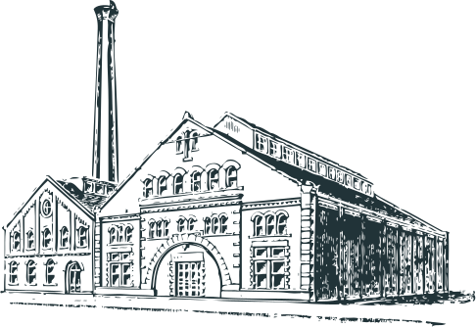





where to find waste?
Reasonable Ask. Ask the Right Person. From the Right Business. Keep Trying; Rejection is not personal.
Look clean and be polite and ask for a specific type of waste. Don’t ask to go through their garbage.
If a staff member can help you reach the prime decision maker regarding waste pick up, you can usually get the waste
This is relevant to all food makers of a certain business size. Go for a small or medium sized business to work with, because you can meet the decision makers.
Be flexible on the amount you can take, but be reasonable with yourself. start small.

Slide 6
how to meet the businesses?
Reasonable Ask. Ask the Right Person. From the Right Business. Keep Trying; Rejection is not personal.
In-Person sometimes you meet a manager or owner at a Pop Up or Event. Let them know you’d like to ask them something and wait for their real customers to thin out into a natural sales lull. Stand to the side and don’t block their income. They will come and talk to you and you can ask them a brief question. They may ask you to call them or email them or text them to follow up. Say OK, look happy with what they have given you, and write to them within the next 48 hours for them to take you seriously.
Online through their Official Channels.
Their Website.
On the Phone if their business takes calls. If they sound really super busy, you can say “you sound busy, I am not a customer, should I call back?” The person who answers the phone might remember your voice later. Respecting the time of all the employees at the business, and especially phone answerers, works almost 100% of the time.

Slide 7
Everyone has seen the in-person demonstration Mini Tank?

Slide 8

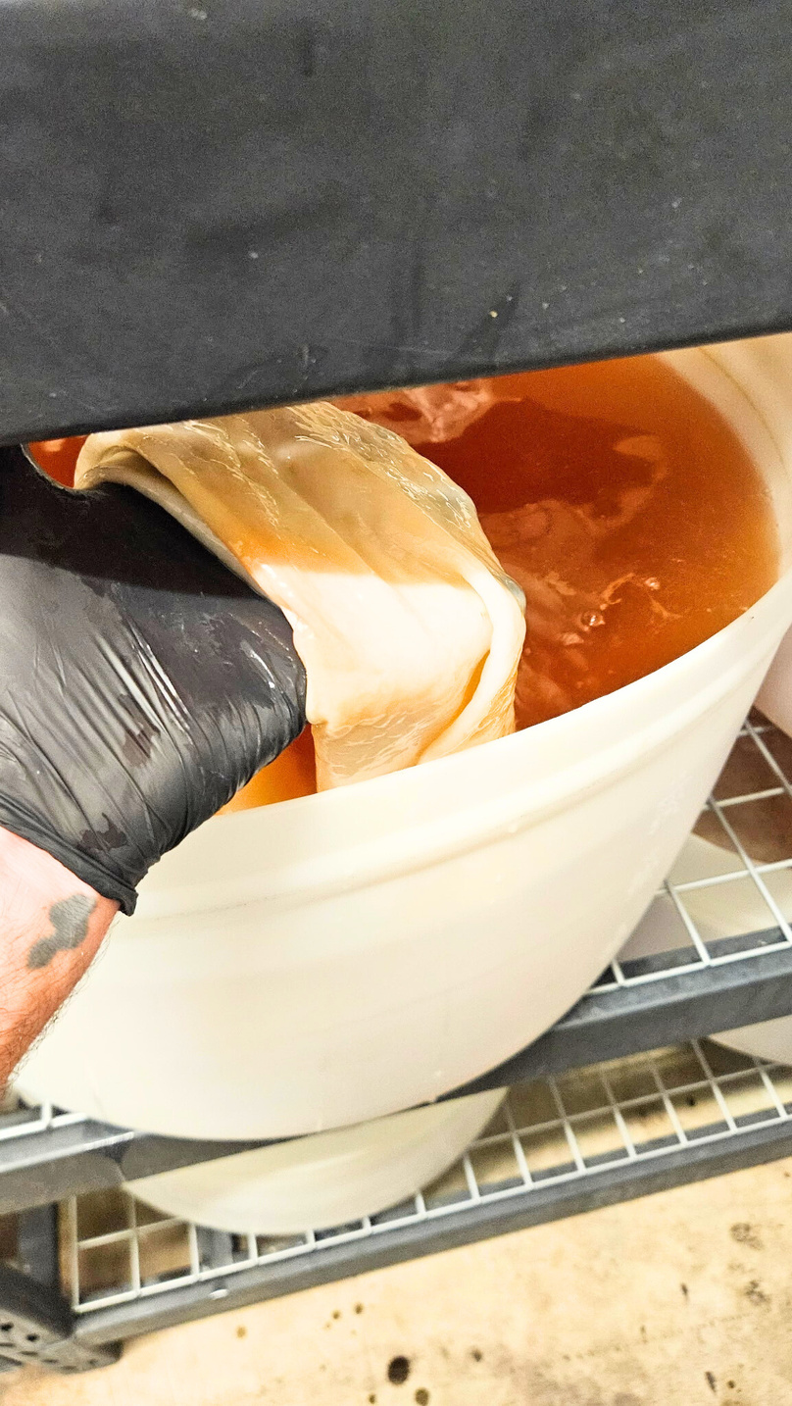

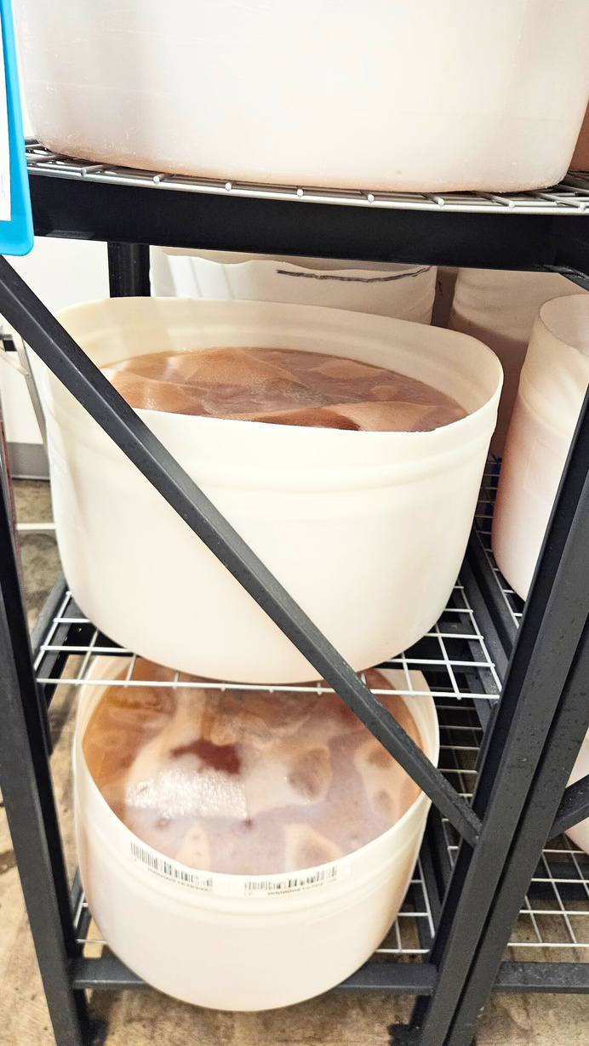
Brewing it?
photos courtesy of Nick Soulias,
Head Brewer, Happy Mountain Kombucha
1
correct temperature
non-contamination survival temperature range of
45 - 95 F
or 5 - 30 C
warmer temperature and higher concentrations of tea and sugar makes the process go faster, but the liquid can become sour
2
sucrose (table sugar)
3
tea with caffeine
photos courtesy of Nick Soulias,
Head Brewer, Happy Mountain Kombucha
pellicle can be grown in any size tank, and it grows on the surface, to the size of the whole surface area

Slide 9
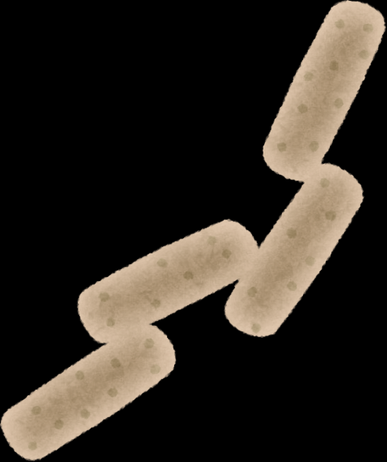






The Pellicle is made by rod shaped vinegar bacteria in multiple genera like Komagataeibacter / Acetobacter
***this is how non sugary parts of plants decompose. Fruit is already sugary, but what about plant leaves? cellulose decomposes. Actually in Nature, first, there is another fermentation before the yeast to get the original plant cellulose into sugars
This species of vinegar bacteria survives the organic chemicals we know as caffeine and alcohol, which other bacteria have a hard time surviving
with exposure to air
Aceto=sour/vinegar Bacter= rod shaped
+
+
inside the tank
Vinegar bacteria eat alcohol and make pellicle mat with their bodies
Yeast makes alcohol by eating sugar. bodies float down because are large and round and their strategy is to fall and knock living yeast down to the most anaerobic, and also often sugary place, usually the bottom of the vessel (think about stirring your coffee or tea)
dried plant juice
rehydrated partially fermented plant leaves steeped in water
+
+
without exposure to air
primary decomposer decomposes cellulose and other complex carbohydrates to sugars, and the yeast and acetobacter do the same thing as in our controlled system

Slide 10
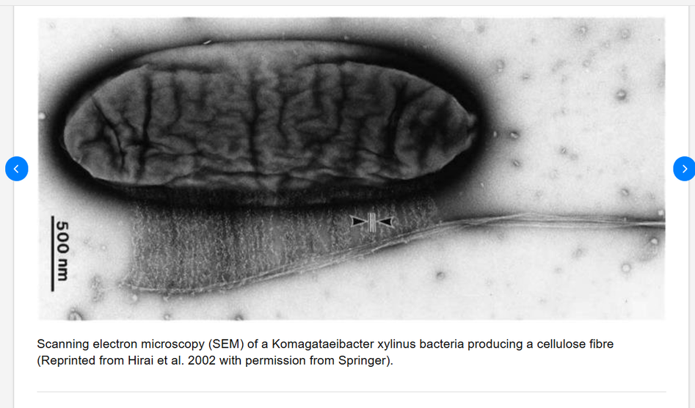
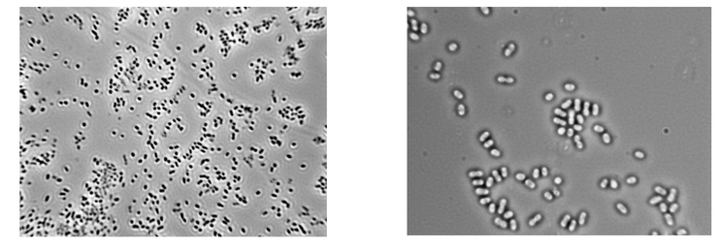
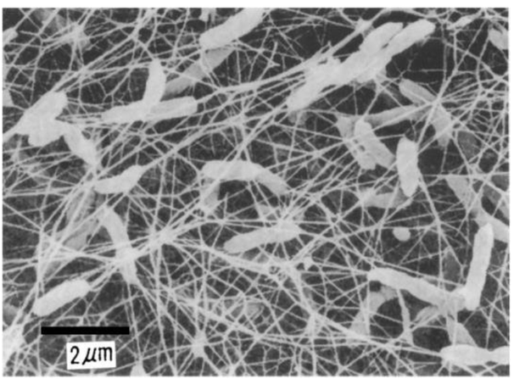
In nature, vinegar bacteria exist on sugar-rich substrates such as such as fruits, flowers, leaves and vegetables. There are a few genus that produce bacterial cellulose other than komagataeibacter. Like Acetobacter, which is known as the vinegar bacteria in wine.
Microscope View
https://wineserver.ucdavis.edu/industry-info/enology/wine-microbiology/bacteria/acetobacter-pasteurianus

Slide 11

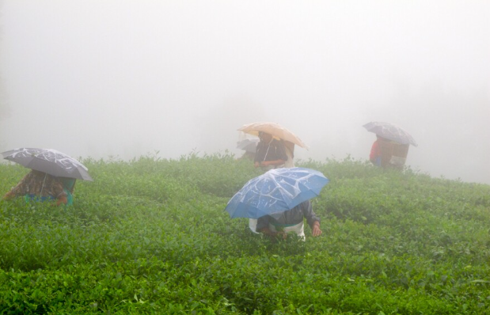
Ideally, the bacterial pellicle would cover a puddle, and would slow down as sugars get eaten up. This is part of how natural items turn back into soil.
The pellicle serves to restart the yeast fermentation more easily next time some sugar and water drops in.
The Natural lifecycle for kombucha bacteria and yeast would be ideal someplace with a rainy warm season, like Asia, where tea comes from and continues to grow in small, medium and largescale operations.
Remember, the optimal brew temperature is around 85....that’s a HOT DAY rain puddle, not an Oregon rain puddle.

Slide 12
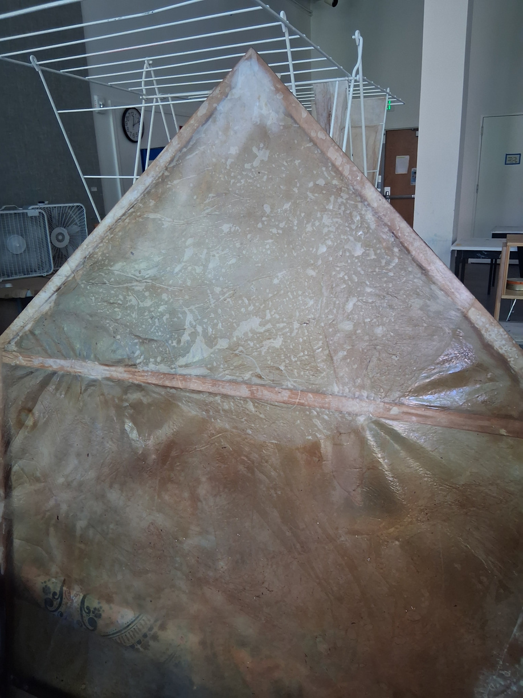
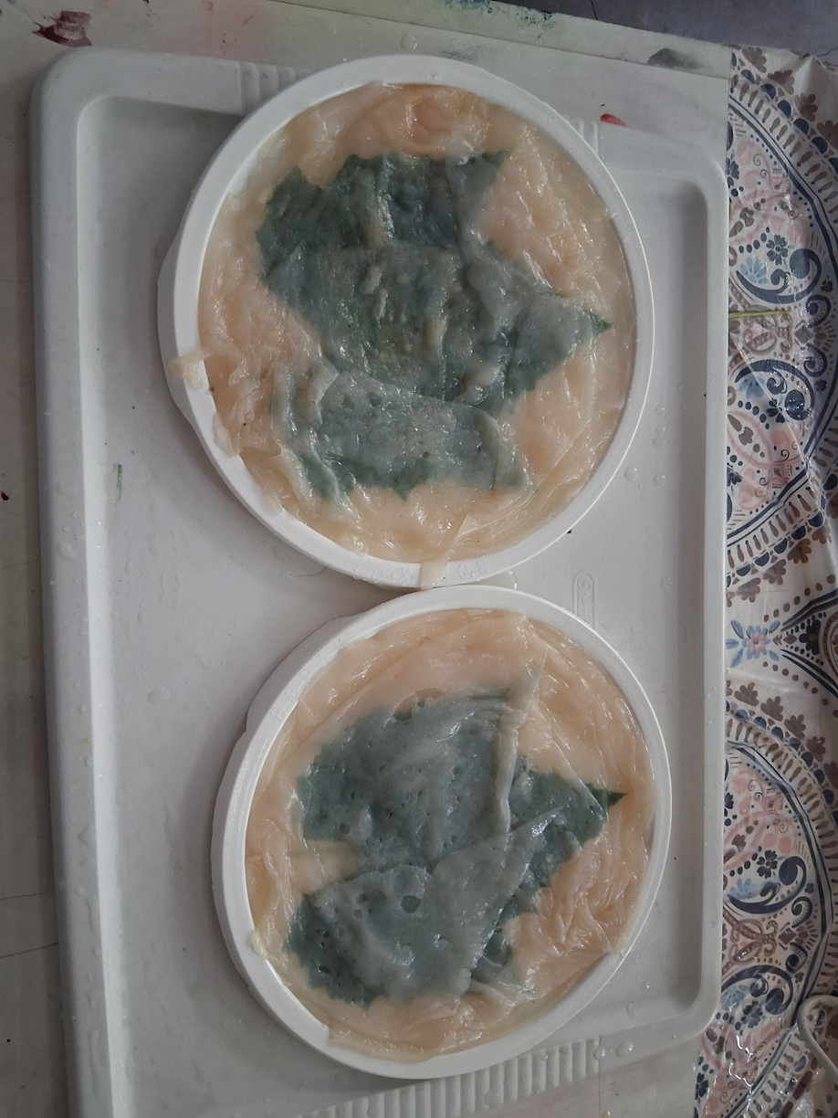
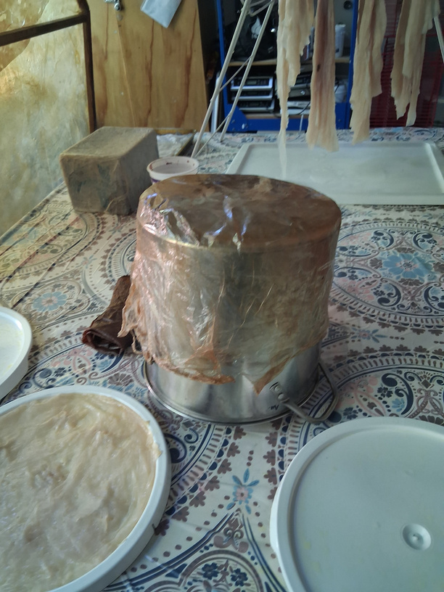
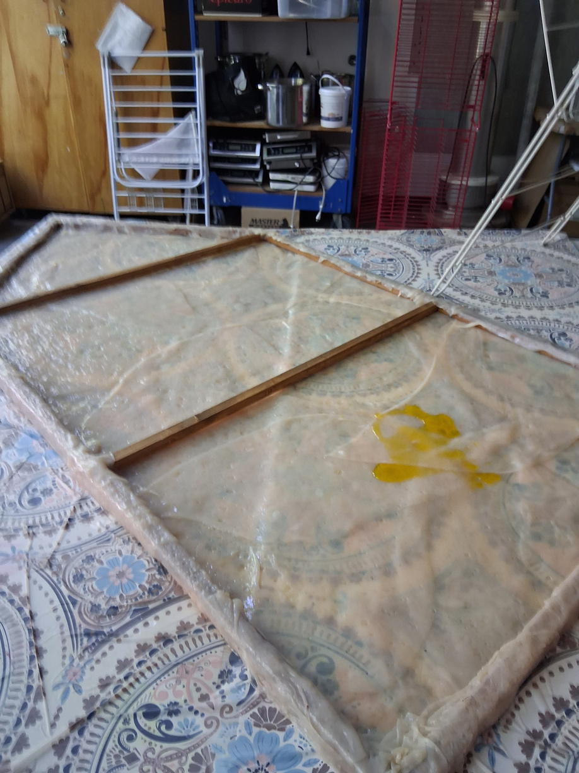
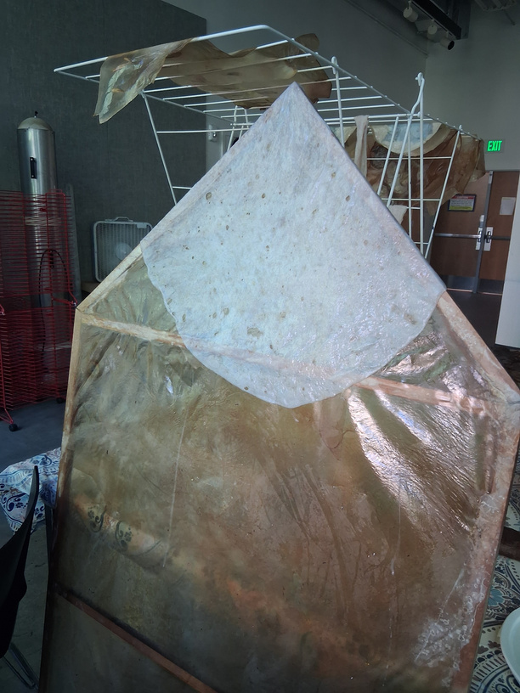
Rinse by dipping - reduces the smell
Steps for using the Pellicle as a textile are similar to hide stretching after removing animal skin
hang it on the frame or mold
it stretches and changes as it dries it its shape
brush with drying oil (flax oil/linseed) and vegetable glycerin to cure it

Slide 13
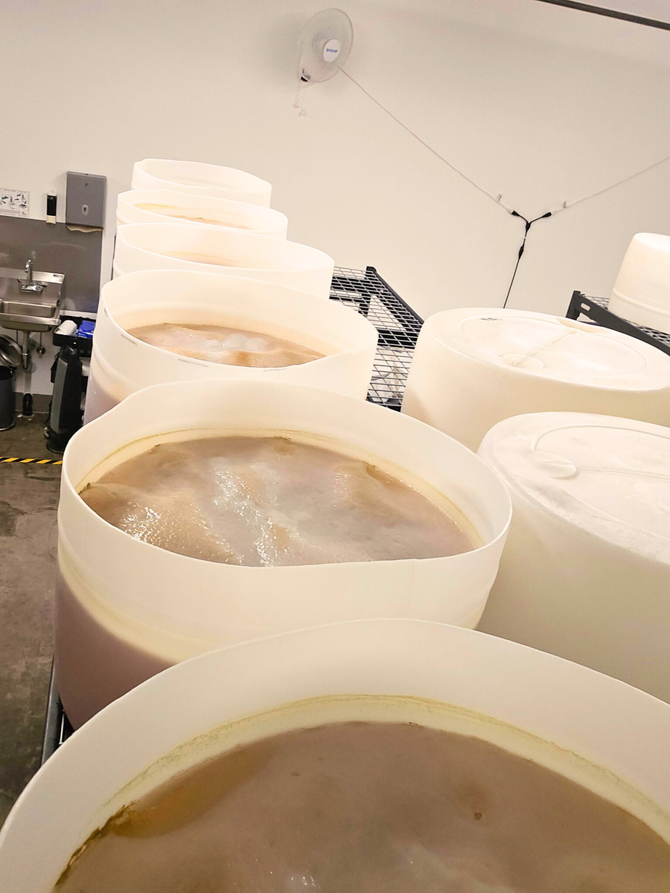
Recipes are Proprietary and are made by using Optomization Technique
from Fermentation Science
In recipe creation, it is important to treat each desired varying outcome of the beverage, like flavor, color, smell, thickness, sweetness, alcohol content, etc as a different thing that can be optimized for. We optimize by using what is in environmental control, and a MAIN component of recipe creation is determining the brew temperature/ingredient balance.
the optimal temperature for brewing the beverage to taste great and have the best effervescence have already been selected for by the brewer.
As lovely as it would be for us materials collectors, they can’t brew to our optimal specs. Find optimal specs online by searching for peer reviewed papers on #biocellulose from the genus #acetobacter and it’s immediate relations. There are several strain names involved, and you can learn about them in their natural habitat as decomposers in nature if you like that too. It is quite an interesting read.
Because the brewer can and absolutely sometimes has to change the recipe overnight, and we don’t want to hinder their creative process, and also because in some cases they really shouldn’t share their company’s EXACT recipe, I would say, don’t bother them about it. Too complicated. If you take up too much of their time, they might not have time to give you their garbage anymore.
?
If you want bulk, don’t sulk!
Be Prepared with PPE
be careful when handling
ANYTHING AT ALL
and also this too,
especially if you are allergic to flavorings, hops, or other ingredients.

Slide 14
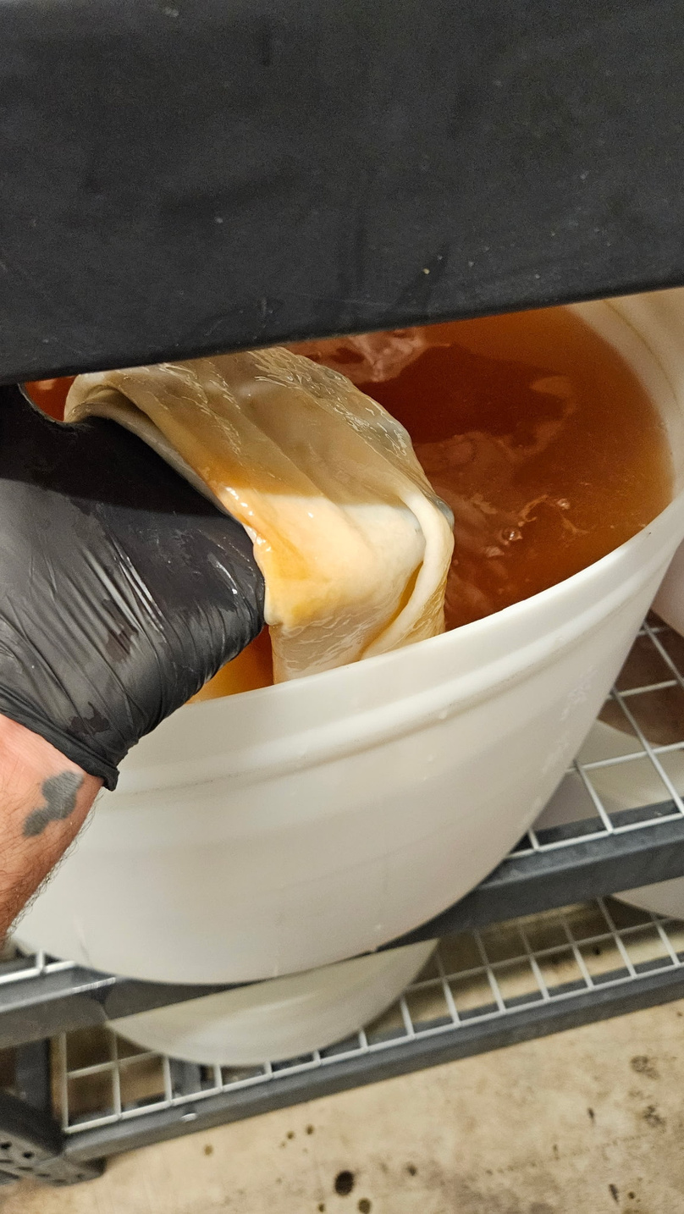
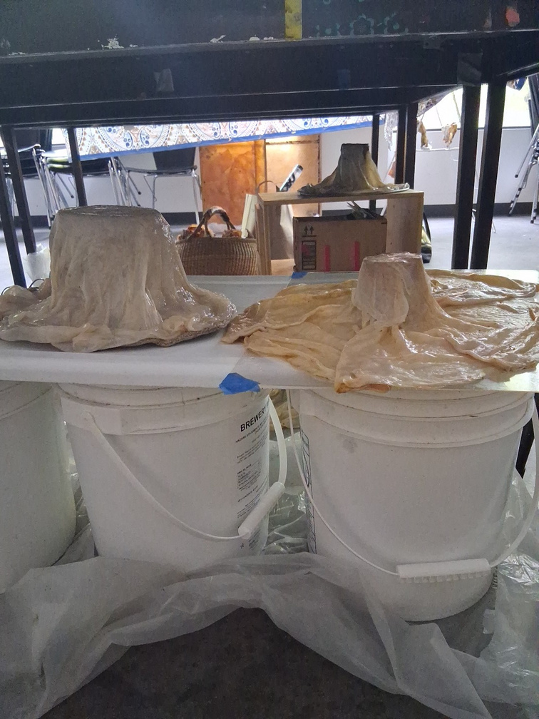
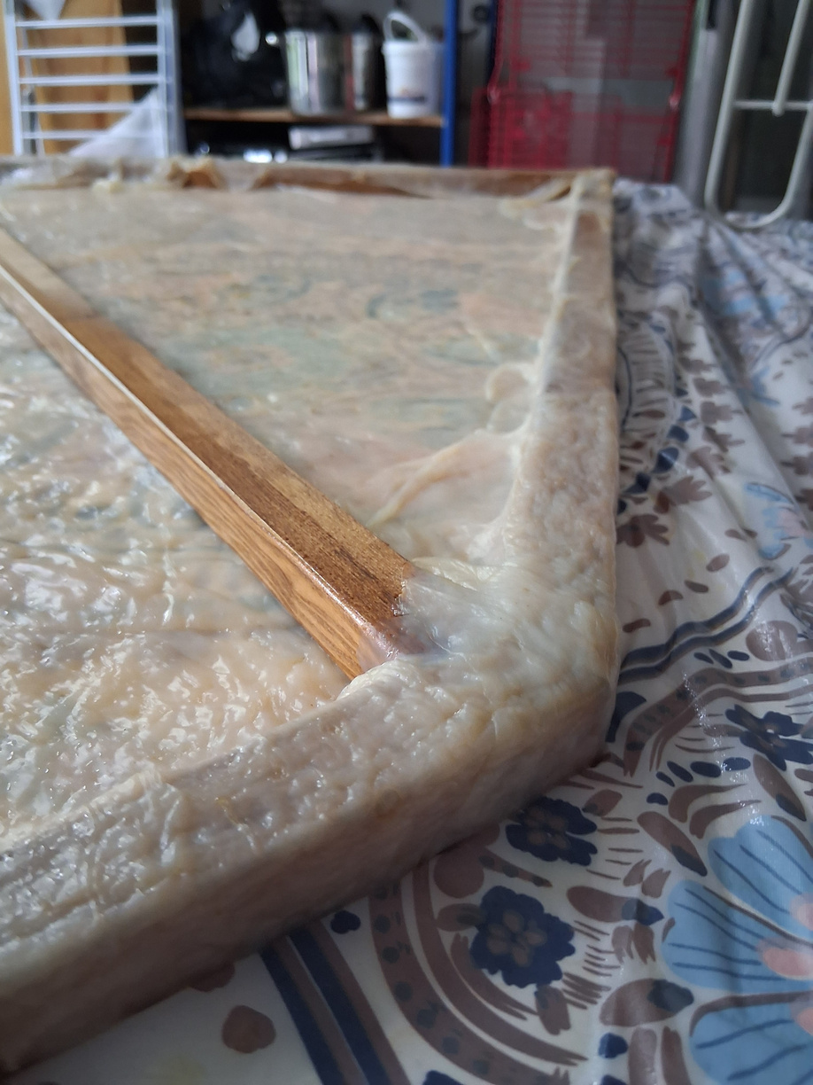
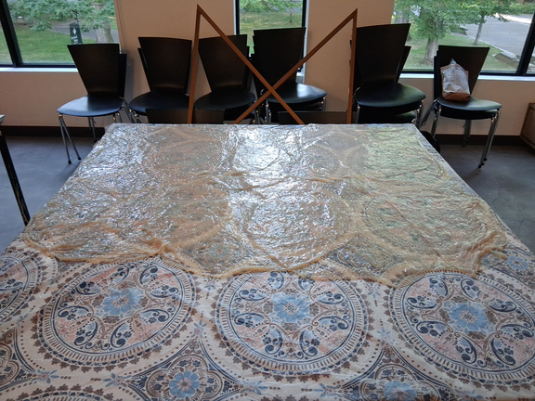
Very Flexible to Work With

Slide 15
Multi Disciplinary is Multi Appeal
each industry, discipline, cultural perspective has terminology and each term turns into a #keyword. Better use of keywords makes you more competitive than your competition. Funding or even Advertising your work requires proper use of keywords.
There are always benefits to cooperating across arts, geographies, or any boundaries
-enology(winemaking)
-textiles
-material science
-public access to participation in research at an urban research university via professors and staff (PSU),
-local brewing industry (Happy Mountain Kombucha, happymountainkombucha.com )
-private sustainable textiles company (SuSeLi llc suselirugs.com )
-solid waste management
-food waste and upcycled food
-public transportation
-trend of N/A brewing and kombucha popularity in general
-trend against microplastics
-trend for natural textiles and natural materials for their own merits other than replacing plastic

Slide 16


“i am not a wall that divides; i am a crack in that wall”
--Kamla Bhasin

Slide 17
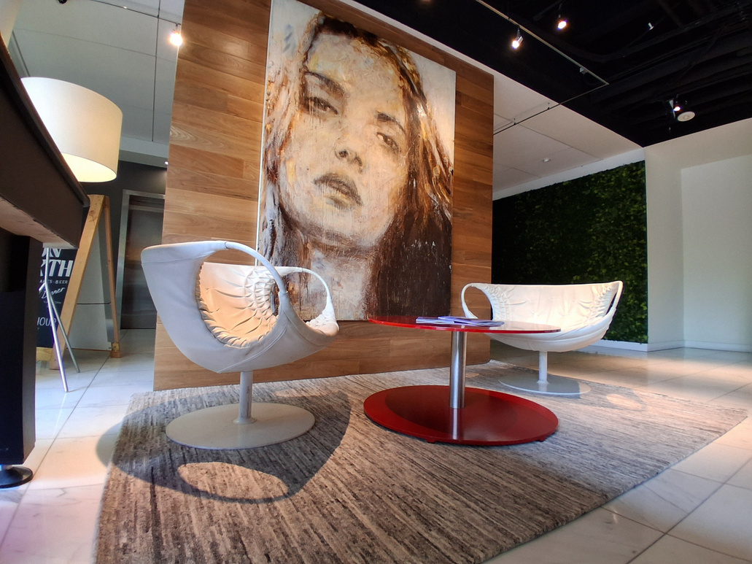
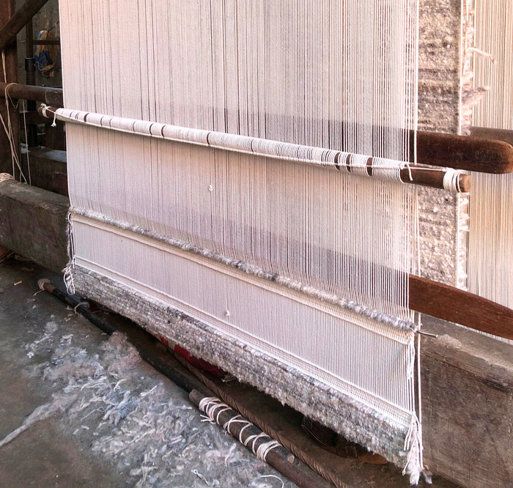
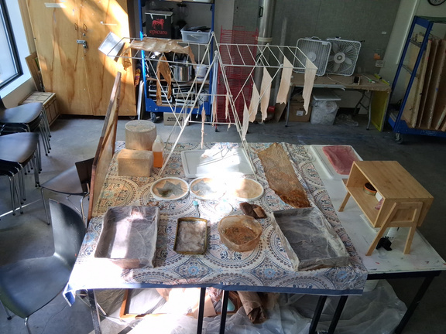
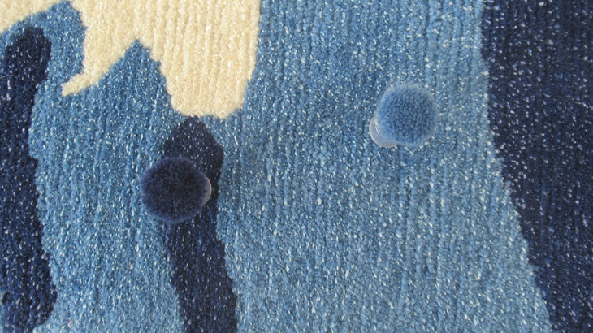
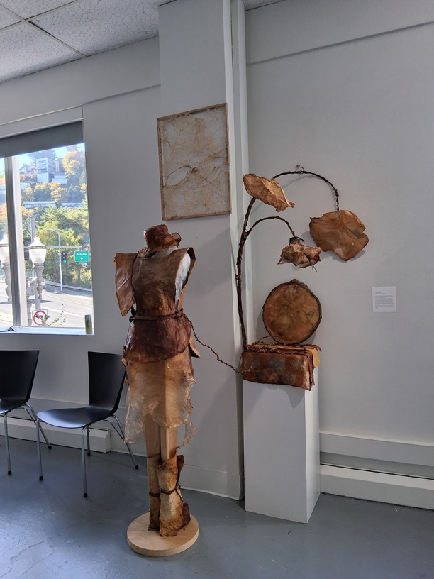
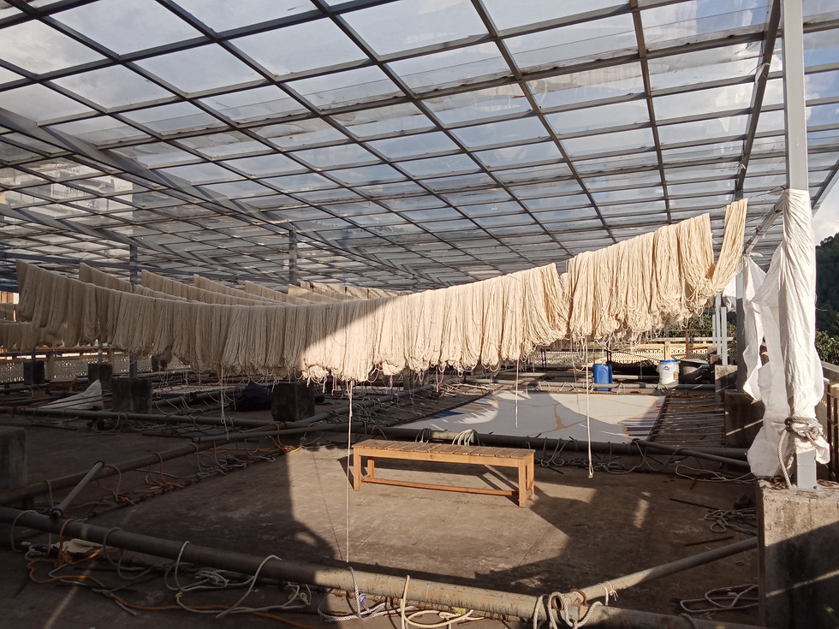
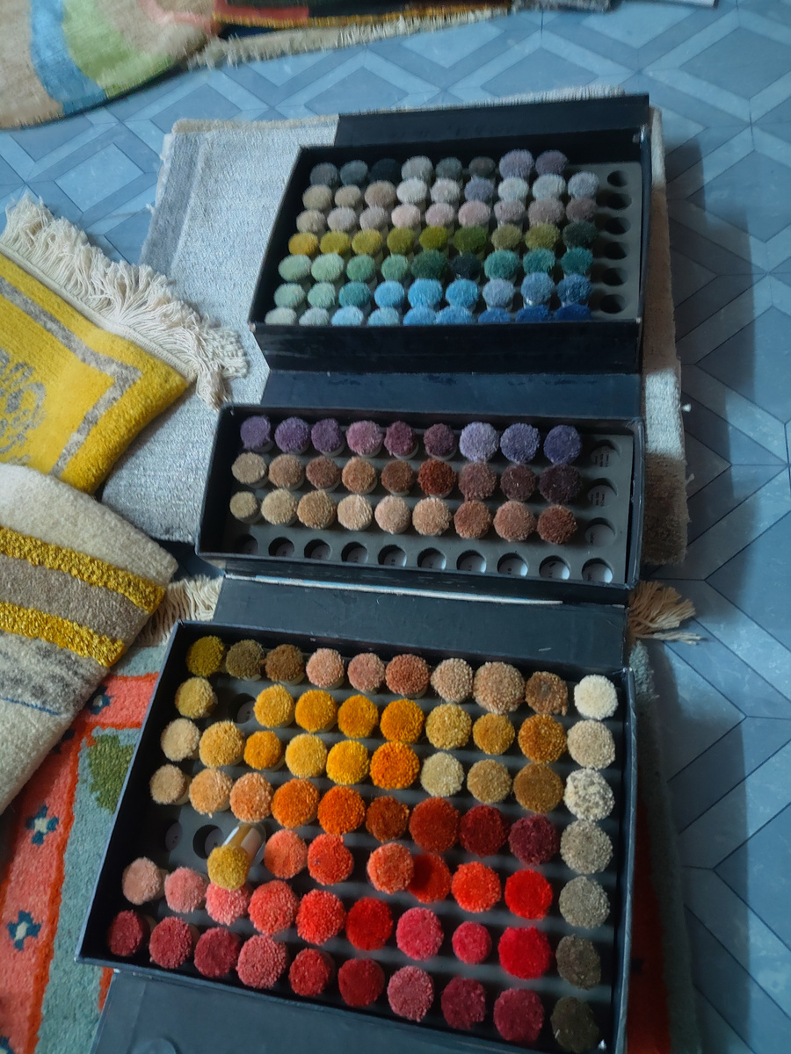

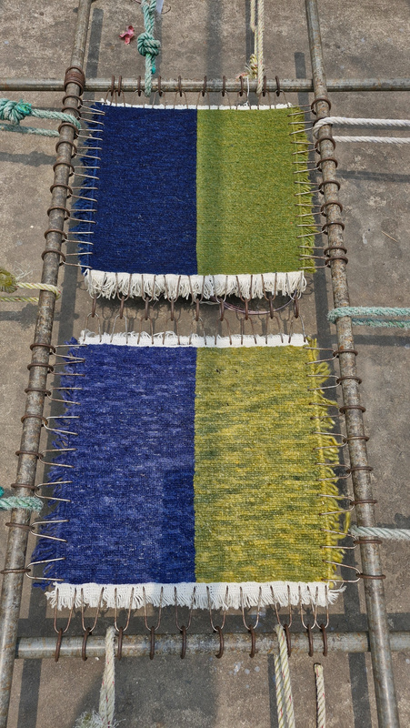
about SuSeLi
natural textile home goods
fairtrade rugs from Nepal
Oregon sustainable textile research

